Slide 1
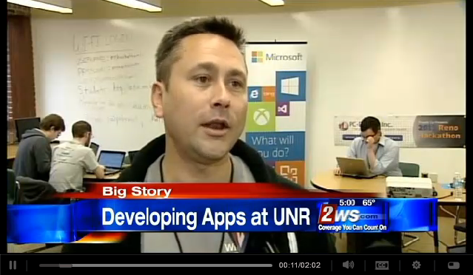
ASP.NET 5
Michael Palermo
Microsoft
mpalermo@microsoft.com
@palermo4

Slide 2
Agenda
State of Affairs
ASP.NET 5 – New Approach
MVC 6
Demo

Slide 3

1.8B
From 64k embedded systems, PCs, tablets, phones, up to and past 64-way Cloud Servers
active installs of .NET
6M
.NET professional developers
Notes:
Talking points
1.8 Billions of active installs of .NET
.NET is everywhere (from embedded systems up to the cloud)
6 million of .NET professional developers
.NET has 1.8 Billions of active installs of .NET, but that is just the number coming from Windows Update. That’s just computers that are actively using .NET and staying current with the latest patches and updates across all versions. If you add to that embedded systems and phones, the number grows even more!.
Not only that, focusing on PROFESSIONAL DEVELOPERS, there are around 6 million .NET Pro devs, that means around 60% of pro developers building business applications.
TBD: Add another line with VS 2013 downloads or as a talking point…
Aditional data:
Xamarin – 8 million C# developers, but that includes non-pro developers, moonlighters, etc.
--
Source: Microsoft figures for total world wide Windows Update installs.

Slide 4
.NET – Current state of Web and Services
Standards
based
Productivity of Visual Studio + Flexibility of Web
Interactive HTML / CSS tools for web apps that look and behave the same across any browser
Highly
interactive apps
Powerful tools and technologies for interactive apps
Develop JavaScript/TypeScript complex logic with powerful editing, debugging and diagnostics.
Suited for
LOB apps
Supports demanding needs of LOB apps
Hybrid cloud requirements, flexibility, productivity,
Tools to develop and test complex web applications that scale.

Slide 5
“Our role is more important than ever before”
“We are required to innovate and deliver much faster”
On the minds of business leaders and the technical community…
“I need a cross-device development strategy”
“Open Source enriches the platform and the community”
“…but I have existing applications to run and evolve”
Notes:
Talking points
You know that nowadays, “every company is a software company”. If your business wants to stay relevant, you need software that can push your core-business to the limits.
In addition to the business applications, the number of web and mobile apps are growing exponentially, so, that’s why the developer role is more important than ever before.
But these new trends related to apps and agile development for the business require us to deliver much faster in a much shorter cadence or even in a continuous motion.
We also hear from you that you need to develop apps for different platforms but you’d like to have a cross-device development strategy so you can share the development investments between the different device platforms.
Finally, you also say, hey!, I know there are new device and cloud trends but I have existing business applications to run and evolve, what is the right way?
Because this feedback and many others, we are changing our approach to building .NET… (go to next slide)

Slide 6

Our new approach to building .NET
.NET innovation
Innovation at the core for your existing and future applications
.NET
Flexibility and agile delivery
Continuous modular releases
OSS
Openness
Transparent, open and community driven
Notes:
This slide would be just about Talking points for the “Future of .NET” slide
WHAT – WHY – HOW
(*) You want .NET innovation and Microsoft investment on .NET.
We’ve invested on .NET innovation from end-to-end, as I’ll show you in a minute. That innovation will benefit future application development but also your existing applications and your existing development experience.
(*) You want flexibility and agile delivery so your applications can have an agile evolution up to date to the latest versions of frameworks and components. That can be achieved by using NuGet packages and Microsoft is betting on NuGet as the mainstream channel for most of the .NET libraries. NuGet is key for .NET vNext and ASP.NET vNext.
(*) You want Openness . Microsoft is heading strongly towards OPEN SOURCE because it is key for a vibrant community and evolving ecosystem. This mainstream in .NET will promote community involvement and will provide the ability to influence and contribute to the .NET roadmap.

Slide 7

ASP.NET 5: The Future of .NET on the Server
New flexible and cross-platform runtime
New modular HTTP request pipeline
Built cloud ready
Agile development with the tools of your choice
Open source http://github.com/aspnet/home
Notes:
The slides that follow address each of the points

Slide 8
New flexible and cross-platform runtime
Flexible and cross-platform CLR hosting
.NET - Maximum compatibility
Cloud Optimized – Be fully self-contained and support true side-by-side versioning!
Mono – Run on Mac/Linux!
Better dependency management
Assembly references → NuGet package dependencies
Integrated runtime compilation with Roslyn
Notes:
Flexible and cross-platform CLR hosting
.NET - Maximum compatibility
Cloud Optimized – Be fully self-contained and support true side-by-side versioning!
Mono – Run on Mac/Linux!
Better dependency management
Assembly references → NuGet package dependencies
Native support for building and consuming NuGet packages and symbol packages
Reference NuGet package directly and leverage NuGet semantics for dependency resolution
Integrated runtime compilation with Roslyn
Build everything up front or deploy source and compile in memory at runtime
Easily replace binary dependencies with code for debugging or for modification
Simple JSON format for managing dependencies and compilation settings

Slide 9
.NET - Cloud Optimized
Slimmed down to just the “Core” (a.k.a. CoreCLR)
No WinForms, WebForms, WCF, WIF, WF, etc.
Modernized API surface area
Use API Portability Analyzer tool to find out what’s different
Factored as NuGet packages
True side-by-side versioning
Notes:
Slimmed down to just the “Core” (a.k.a. CoreCLR)
No WinForms, WebForms, WCF, WIF, WF, etc.
Modernized API surface area
Cleaned up for better factoring
Continuation of Windows Store .NET API contracts, extended for the server
Existing binaries will probably need to be updated – use ApiPort tool to find out what’s different
Still lots of API gaps, but more stuff being added with every NuGet release
Factored as NuGet packages
New features ship as new independent packages on NuGet
Better versioning for simplified deployment
Bin deploy the pieces of the .NET framework you need with your app – including the CLR!
Completely self-contained apps that support true side-by-side versioning

Slide 10
New modular HTTP request pipeline
Modular
Fast and lean
Flexible hosting
Supports OWIN
Notes:
Modular
Get high productivity with built-in or community contributed middleware and frameworks
Use a stripped down pipeline for bare metal performance
Fast and lean
Light weight HttpContext
Highly optimized IIS integration and WebListener for maximum throughput
Flexible hosting
Run both in IIS and hosted in your own process
Supports OWIN
But doesn’t force you to code against the raw OWIN abstractions
Easily migrated Katana middleware to this new model

Slide 11
Built cloud ready
New environment based config system
No more complicated web.config and config transforms
Integrated DI
Reduce COGS
Integrated tracing and diagnostics
ETW, App Insights
Notes:
New environment based config system
Pick up the appropriate config values for the environment you are running (dev, staging, prod)
Read name/value pairs from a variety of sources (JSON, XML, INI, environment variables, etc)
No more complicated web.config and config transforms
Integrated DI
Use common DI abstraction in inject services appropriate for the environment
Replace the built-in container with your favorite IoC (Ninject, Autofac, Unity, StructureMap, etc)
Reduce COGS
Run on the Cloud Optimized runtime for higher runtime density and better resource utilization
Integrated tracing and diagnostics
ETW, App Insights

Slide 12
Agile development
Premier developer experience in Visual Studio 2015
Leverage online or third party editors
Cross-platform command-line support
k k runtime – runs the application
kvm k version manager installs / manages versions
kpm k package manager installs / manages packages
Notes:
Premier developer experience in Visual Studio 2015
The agility of a dynamic environment with the power of .NET
Fully integrated with new runtime artifacts – project.json, config.json, global.json
Easily visualize, manage and manipulate dependencies
Cross-platform command-line support
K Version Manager (kvm): Manage runtime versions
K Package Manager (kpm): Create and install NuGet packages
K <cmd>: Run apps and commands
New command-line scaffolding
Leverage online or third party editors
Deploy as source and edit your app on the server (ex. Visual Studio Online)
Code in your editor of choice

Slide 13
ASP.NET 5 - Compatibility
Web Forms, MVC 5, Web API 2, Web Pages 3, SignalR 2, EF 6
Fully supported on .NET vNext
MVC, Web API, Web Pages 6, SignalR 3
Run on new runtime and request pipeline only (no System.Web.dll)
Merged MVC, Web API, Web Pages framework
New project system
New configuration system
.NET vNext (Cloud Optimized)
Subset of the .NET Framework
Modernized API surface area
Things you depend on might not be available yet (images, etc)

Slide 14
The world today – similar, but different
Web Pages
MVC
Web API
Razor
HTML Helpers
HTML Helpers
Controllers
Controllers
Actions
Actions
Filters
Filters
Model binding
Model binding
DI
DI
Notes:
Visual of different features, to be merged in next slide

Slide 15
MVC + Web API + Web Pages = ASP.NET MVC 6!
Notes:
WebForms are not part of MVC 6

Slide 16
Frameworks – all the familiar faces
MVC 6: Aligned MVC, Web API, Web Pages
One set of concepts – remove duplication
Web UI and Web APIs
Smooth transition from Web Pages to MVC
Built DI first
Runs on IIS or self-host
Based on the new request pipeline in ASP.NET 5
Runs cloud-optimized!
Other frameworks you know and love
SignalR, Identity, Entity Framework

Slide 17
ASP.NET 5 Demo
Creating an ASP.NET 5 Empty Application
Notes:
For step-by-step walkthrough:
http://palermo4.com/post/Creating-an-ASPNET-5-Empty-Application.aspx

Slide 18
ASP.NET 5 Resources
http://www.asp.net/vnext
http://www.palermo4.com/post/ASPNET-5.aspx

Slide 19

As we countdown to conclude…

Slide 20
…start evaluations for give-a-way

Slide 21
What we learned today
Visual Studio
Microsoft Azure
NuGet
ASP.NET

Slide 22
What we learned today
Sites
Services
Web
Forms
Web
Pages
Single Page Apps
SignalR
MVC
Web API
ASP.NET
Notes:
Estimated Time: 2 minutes
No matter which type of developer you are, you get the benefit of the ASP.NET Core runtime, which provides many useful modules that provide functionality that you are likely to need when creating web applications. For example: Profile, Roles and Membership is important if you want to build in users and security around different parts of your website.
[Build x 3]
ASP.NET Web Forms, ASP.NET MVC and ASP.NET Web Pages are three different approaches to building web applications on the server side with ASP.NET. They all build on top of the same core runtime that provides them with the same powerful set of modules that web developers can leverage from within their web applications.
ASP.NET Web Forms is great for developers coming from desktop application development where they are accustomed to controls, event-driven development and code-behind. Despite not being concepts that are native to the web, Web Forms achieves this by abstracting away things like maintaining state, form posting and much more. This ease of development means that developers relinquish a certain amount of control as Web Forms manages communication between the server and client on your behalf.
ASP.NET MVC, in contrast, is for developers that like to be in full control of the interactions between client and server and provides a more “raw” approach to what happens in the web application. Due to its loosely coupled architecture, MVC is also very extensible with many places for developers to customize and plugin components as well write test code easily.
Developing in ASP.NET Web Pages is centered around inline code and is similar to PHP or classic ASP in that compilation of your application isn’t required (it is in WebForms and MVC). It is designed to provide the simplest approach to building websites with the fewest number of concepts to learn.
[Build x 2]
When it comes to controlling the markup that is rendered to the client there are two view engines you may use. The Web Forms view engine is shared by both Web Forms and MVC and uses the familiar <% %> syntax. With ASP.NET MVC 3 and ASP.NET Web Pages Microsoft introduced the Razor View Engine which uses a different syntax centered around the @ symbol. The Razor syntax uses fewer characters to achieve the same things in Web Forms and allows the developer to mix markup and code really easily.

Slide 23
What we learned today
Introduction to ASP.NET and Visual Studio 2013 Web Tooling
Building Web Applications using the latest ASP.NET technologies
Building web front ends for both desktop and mobile using the latest web standards
API Services for both web and devices
Running, improving and maintaining a site in the real world
Real-time Communications with SignalR
Notes:
Note: Should add other key scenarios we won’t be covering in depth

Slide 24




What you can do next
Build
Contribute
Grow

Slide 25
Top resources for more info

Slide 26
ASP.NET Questions
http://www.asp.net/feedback
Twitter - @aspnet
Facebook - /ASPNET
G+ - ASP.NET

Slide 27
Web Camps
http://www.devcamps.ms
http://aka.ms/webcamps-training-kit

Slide 28
Microsoft Azure
http://azure.microsoft.com

Slide 29
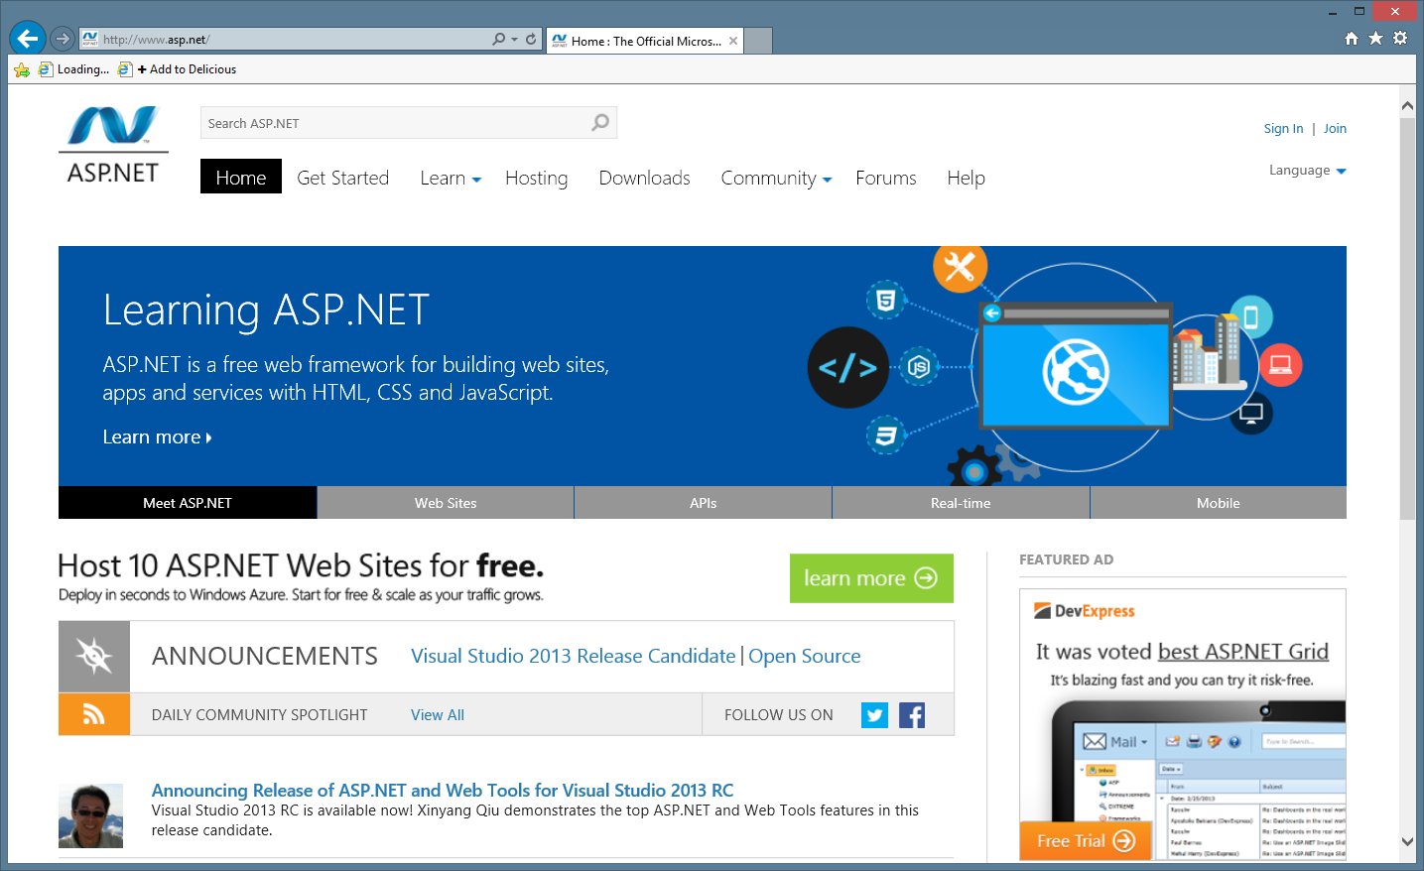
ASP.NET site

Slide 30
$100 coupon give-a-way

